Slide 1
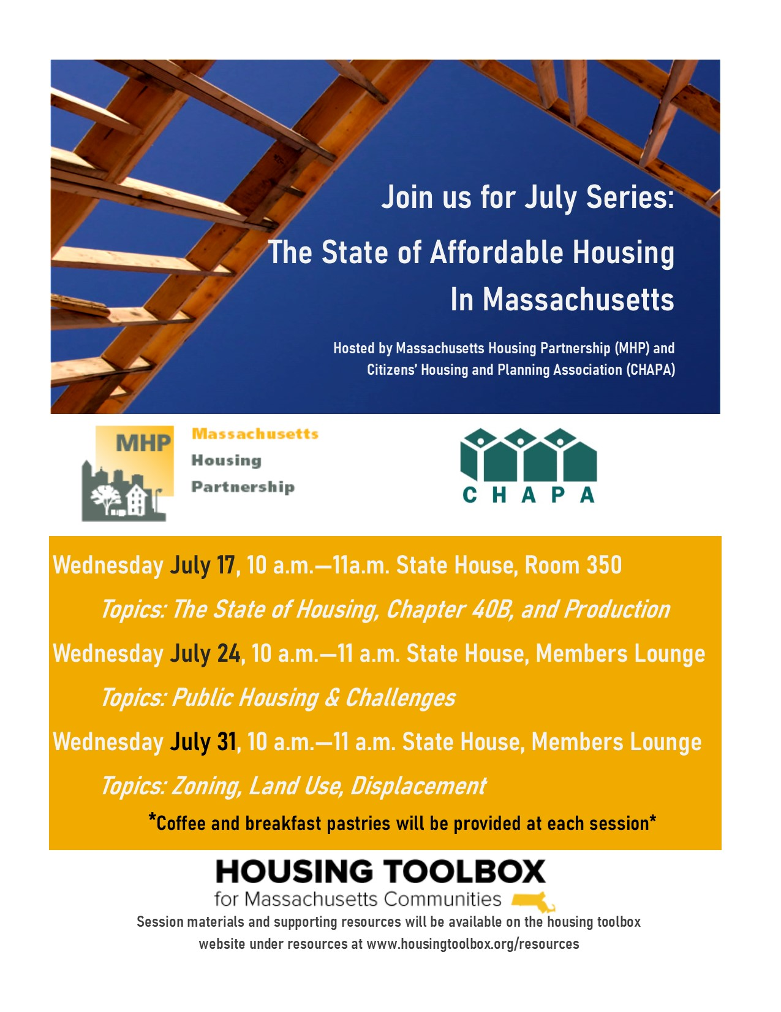
Notes:
Welcome back to the final session 3 on “The State of Affordable Housing In Massachusetts”
I’m Callie Clark and I’m the Co-Director of the Center for Housing Data at MHP. Before we start this morning, who came to our first session on Ch. 40B? And our second session on public housing? Both?
Ok, well today we’re going to talk about something that really underpinned all of the topics up to this point. Zoning and land use.
A quick reminder that all of the information from last session, all three weeks of material will be available on our HousingToolbox website

Slide 2

Who we are
Massachusetts Housing Partnership (MHP) is a quasi-public agency created by state statute in 1985
Increase the supply of affordable housing in the state
Work with municipalities to demonstrate new and better ways of meeting our affordable housing needs
Notes:
A reminder for those of who joined us last week…
MHP was created in 1985 by state statute w/ a goal to “increase the supply of affordable housing in the state” and to “work with municipalities to demonstrate new and better ways of meeting our affordable housing needs”

Slide 3
What we do
Community Assistance team
Permanent financing for affordable rental housing
ONE Mortgage program
Research on housing data to support policy efforts
Notes:
And we support those goals through the work of four different teams:
The Community Assistance team helps communities build housing; provided assistance in one way or another to more than 335 of our 351 cities and towns.
Rental Financing – financing of more than 24,000 rental units in Massachusetts since 1990 through a state statute.
ONE Mortgage – first time homebuyer programs that has helped more than 21,000 families buy their first home.
The creation of the Center for Housing Data in April 2017.
We’re hosting this sessions to provide you with information to use in upcoming meetings and conversations with, and in response, to your constituents. Here’s what we’re going to cover today:
1) we’re building less, 2) homeownership and rental prices are increasing, 3) other regions are producing more than us, 4) lack of coordination between local and regional level (like transportation and housing infrastructure) can lead to unintended consequences, 5) housing cost burden is high for all but especially the people making the least amount of money, 6) MA is leader in building subsidized affordable housing but it isn’t enough, 6) resources you can use after these sessions

Slide 4
351 zoning jurisdictions in Massachusetts
Massachusetts cities and towns that are equivalent in population to a single zoning jurisdiction in Fairfax County, VA
In metropolitan Washington, DC, for example, the Fairfax County Board of Supervisors makes land use decisions for nearly a million Virginia residents. In Massachusetts, permitting decisions for that same metro area population would be made by 38 cities and towns serving a median of less than 17,000 residents each.

Slide 5
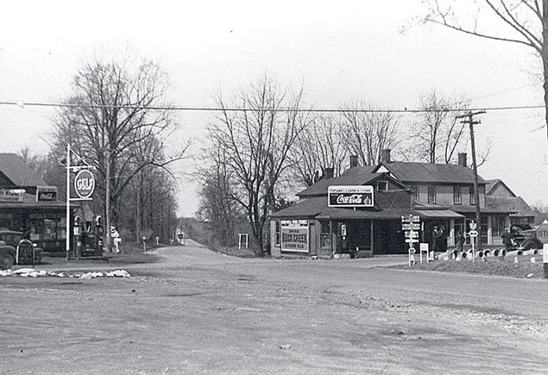
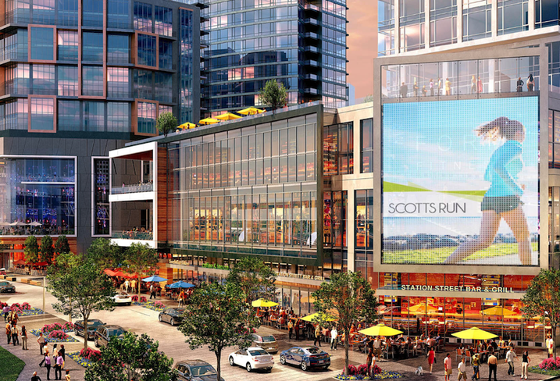
Transforming Tysons, VA
“By 2050, Tysons will be transformed into a walkable, sustainable, urban center that will be home to up to 100,000 residents and 200,000 jobs. Tysons is envisioned to become a 24-hour urban center where people live, work and play; where people are engaged with their surroundings; and, where people want to be.”
Circa 1935
Proposed
Notes:
Population doubled from 10,065 in 1980 to 19,627 in 2010
Similar communities in MA:
-Norton (12,690 in 1980 to 19,031 in 2010)
-Sandwich (8,727 in 1980 to 20,673 in 2010) → more than doubled!
-Westford (13,434 in 1980 to 21,951 in 2010)

Slide 6
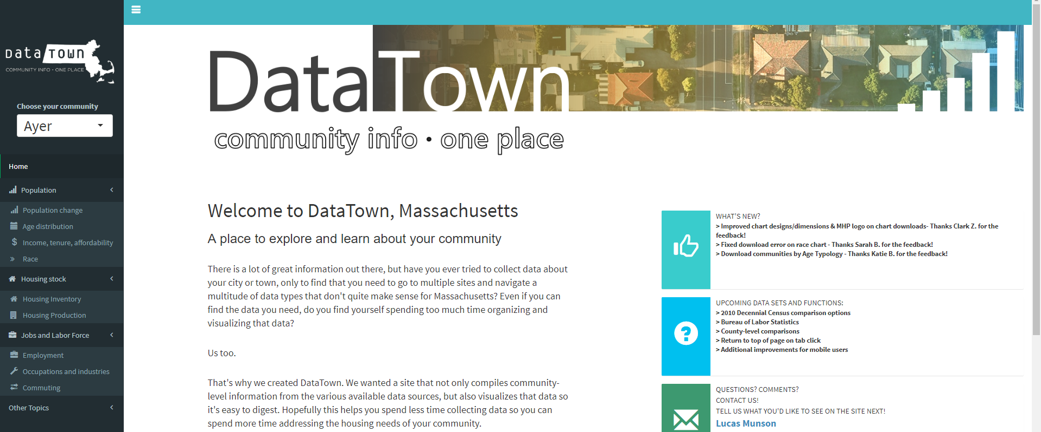
www.mhp.net/datatown
Notes:
So those are the challenges we face today related to housing. Our goal with this session and future sessions is to provide you with the information, resources and tools to take action in your district or be able to better respond to consistent questions related to housing.
One-stop shop for data so that you don’t have to hunt down the individual pieces
Coaching text
Grab-and-go graphics
Data downloads
Responsive to its users
Multiple data sources
Last week we got a big bump in people visiting the website after this session. For those of you who visited, I’d love to hear what you learned and if you were able to find any information that was useful for your work last week.

Slide 7

www.housingtoolbox.org
Assessing needs
Local tools (NEW)
Local support
Zoning and land use
Fair housing
Housing development process
Financing and funding
Case studies & best practices (NEW)
Resources
Notes:
So you’re scrolled through DataTown, maybe you used a few graphics in a presentation or as backup in a meeting. People are on board w/ thinking about housing. GREAT! But what do you do next. Well that’s where the Housing Toolbox website comes in.
Created in 2017 in partnership with MHP and CHAPA, the Housing Toolbox website is the place to go when you don’t know how/where/what to start the conversation AND when you’re looking for specific resources.
Provides the context, explains all the resources and list the tools that are available so that communities can spring into action. Sections include:
Assessing Needs
Local Support
Zoning and Land Use
Fair Housing
Housing Development Process
Financing and Funding
Case studies and best practices – Natick, Scituate and Orleans
Resources – Local Action Units (LAU) guide is new

Slide 8
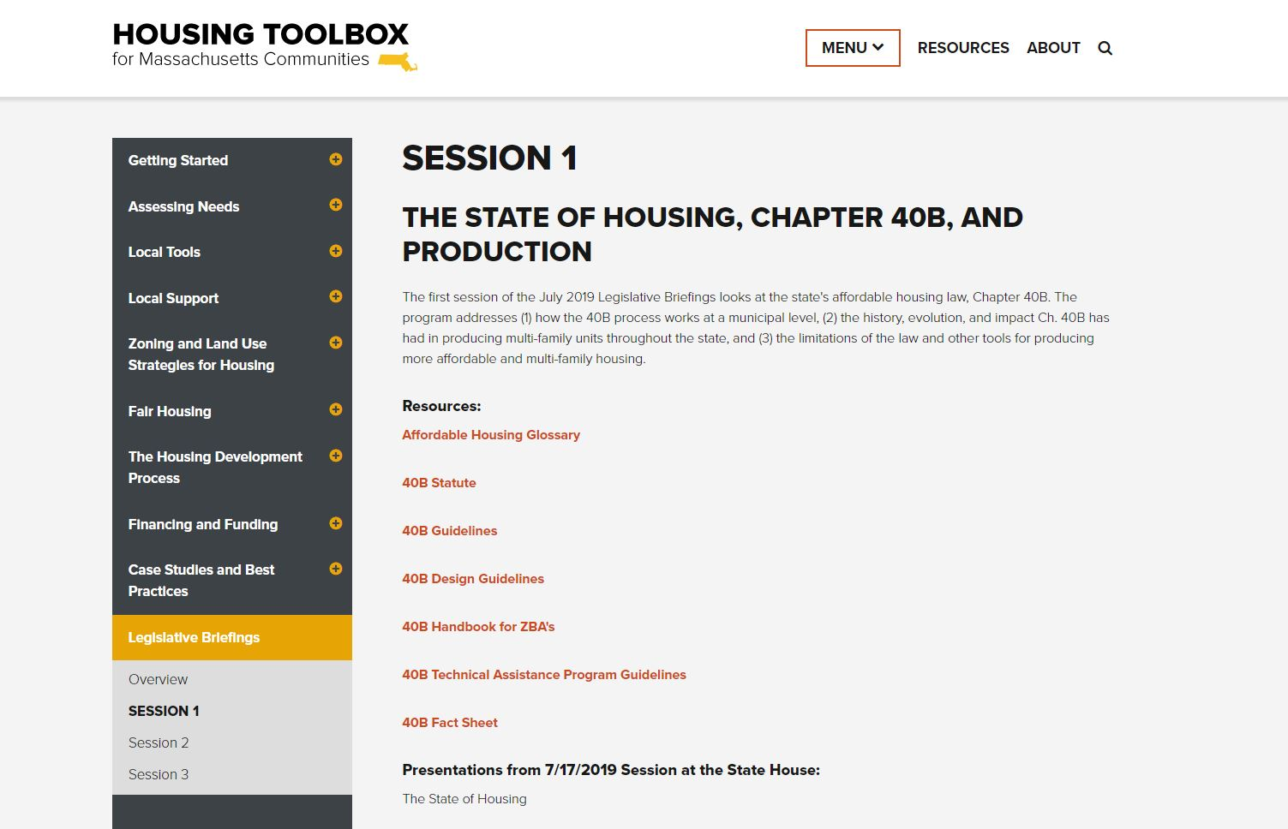
Notes:
And a quick reminder that we’ll be featuring all the resources mentioned in all session, as well as all presentations, on the Housing Toolbox website. Just click on the menu at the top of the page and select “legislative briefings.”

Slide 9

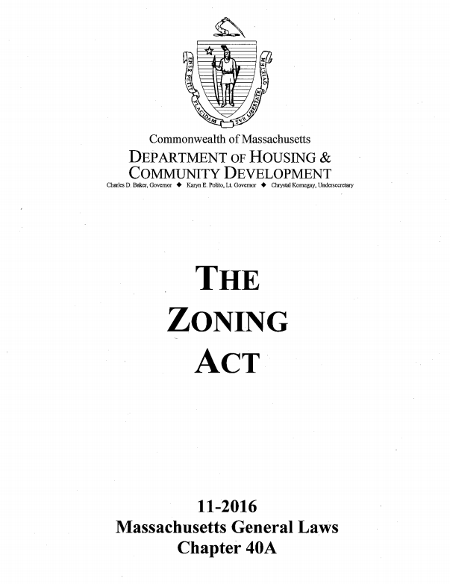
Planning for Affordability
What’s Zoning Got to Do With It?

Slide 10
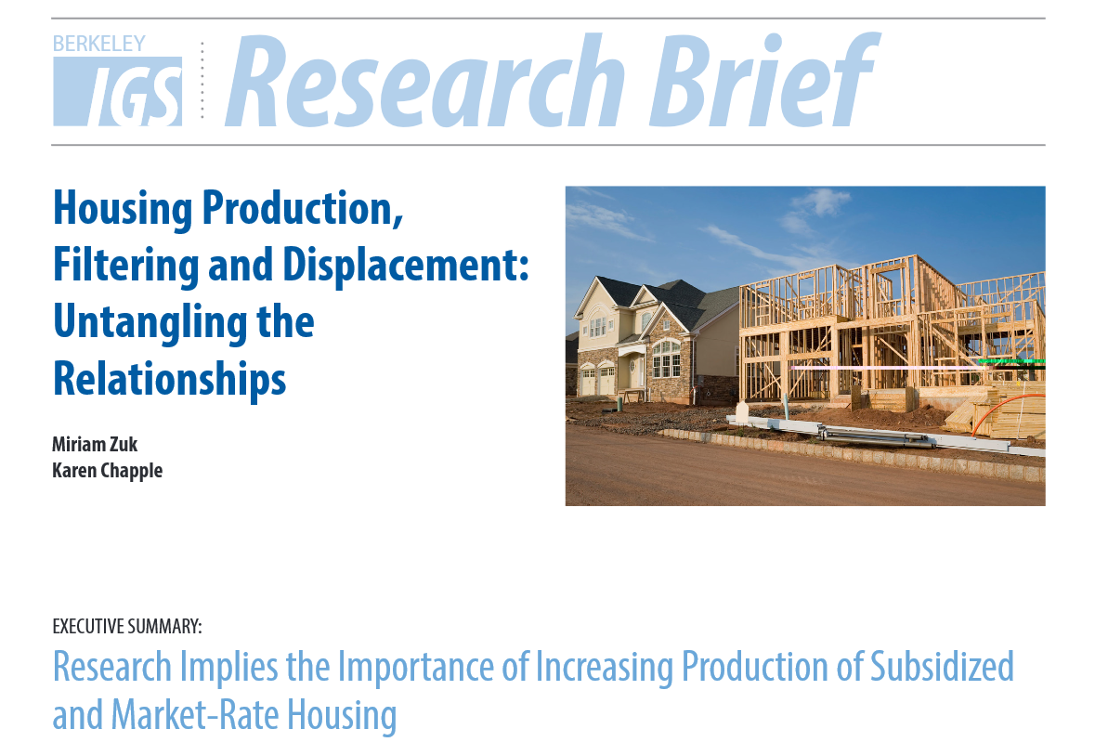
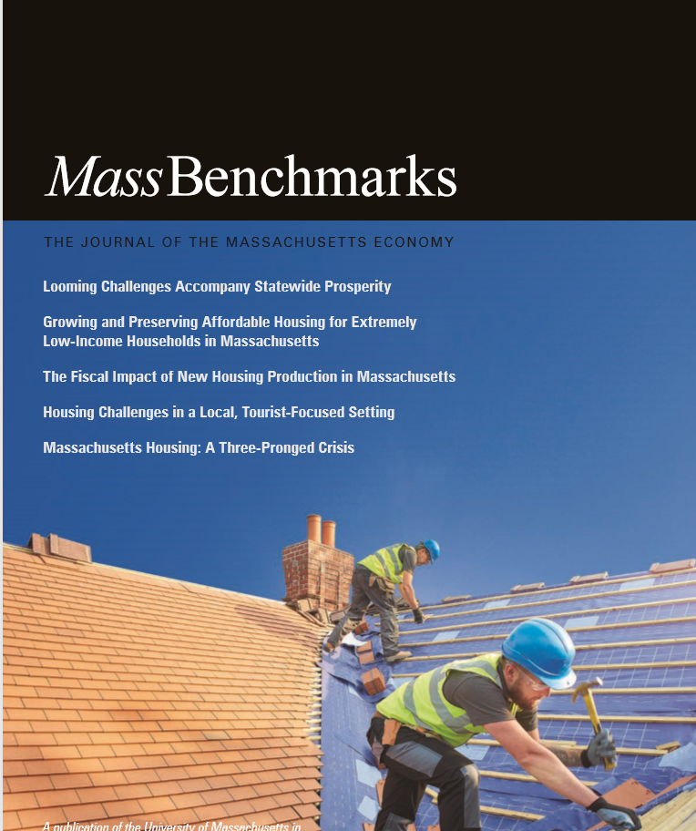
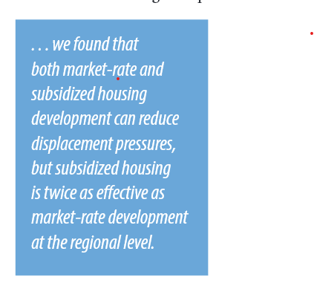
What can we learn from other states? Report from California / San Francisco area

Slide 11
“affordable” vs. “Affordable”
Naturally occurring affordability;
i.e. “Woah I can’t believe what a good deal this apartment is!” Anyone can live there, as long as you make it past the landlord’s checks.
Built with local, state or federal funds, or uses these funds to operate.
Has restrictions on maximum incomes, and maximum rents. Only people earning less than a certain max income can qualify to live there.
Notes:
Carsten starts again
There are a lot of complexities– could be a full day
A lot of the new housing is unrestricted, set at rents according to the hot market
Naturally occurring vs. with restrictions
Restrictions are based on “Area Median Income” or AMI
Examples of “Affordable” income
Why do we have “Affordable”– people that are always priced out of market, some history

Slide 12
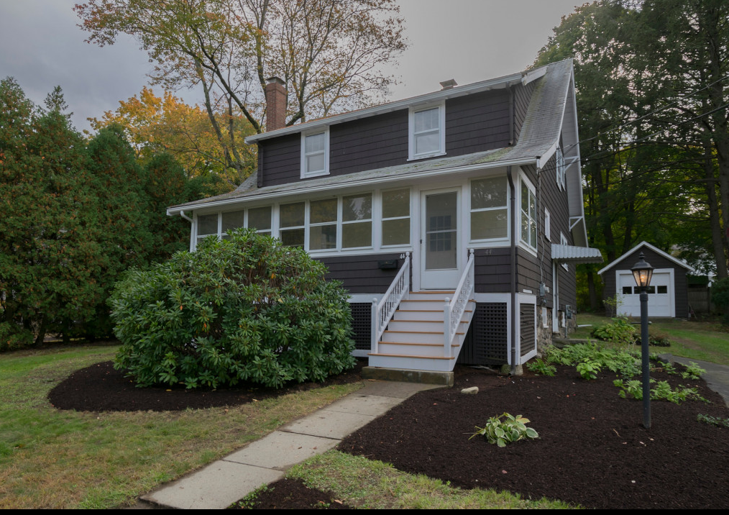
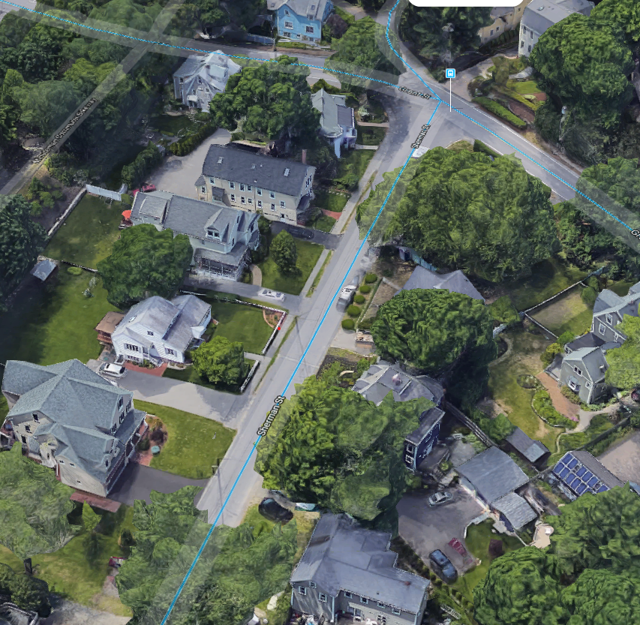
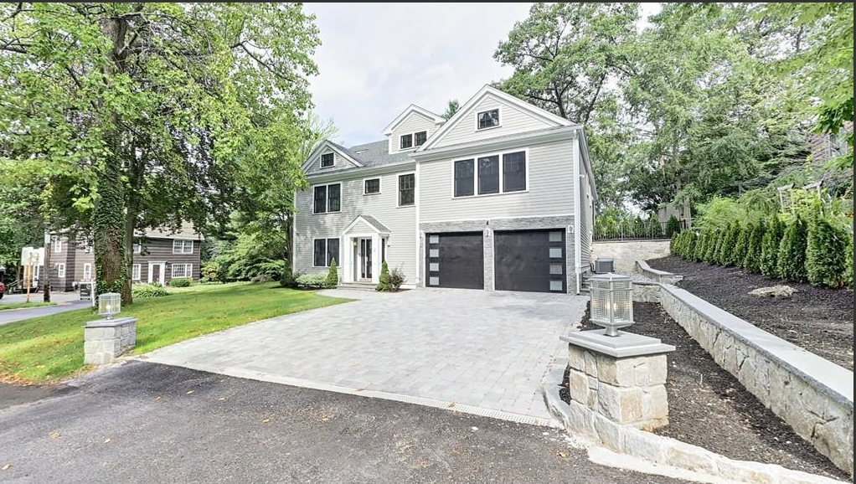
How zoning and resulting land uses effect cost
FAR, IZ, housing type (single, multi) lot size requirements, set backs, etc.
Existing 1300 sf home
8,000 sf lot
$550,000 (upgrades needed) but no tear down
Tear down site
5,500 sf home
8,700 sf lot
$2,000,000
Cannot build two family as of right
Historic town center area
Multi-family, small lots, larger buildings, single family; variety, moderate land use.

Slide 13
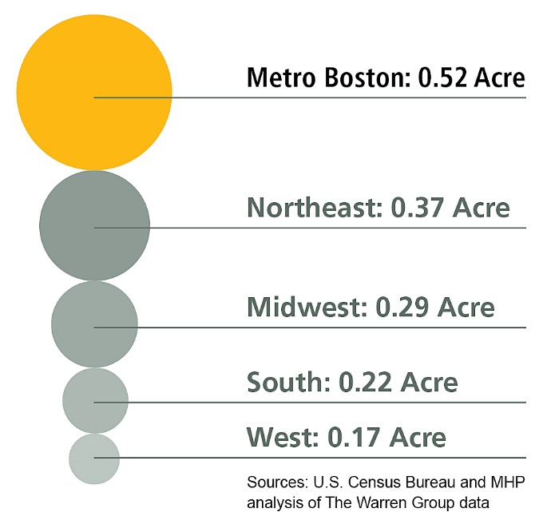


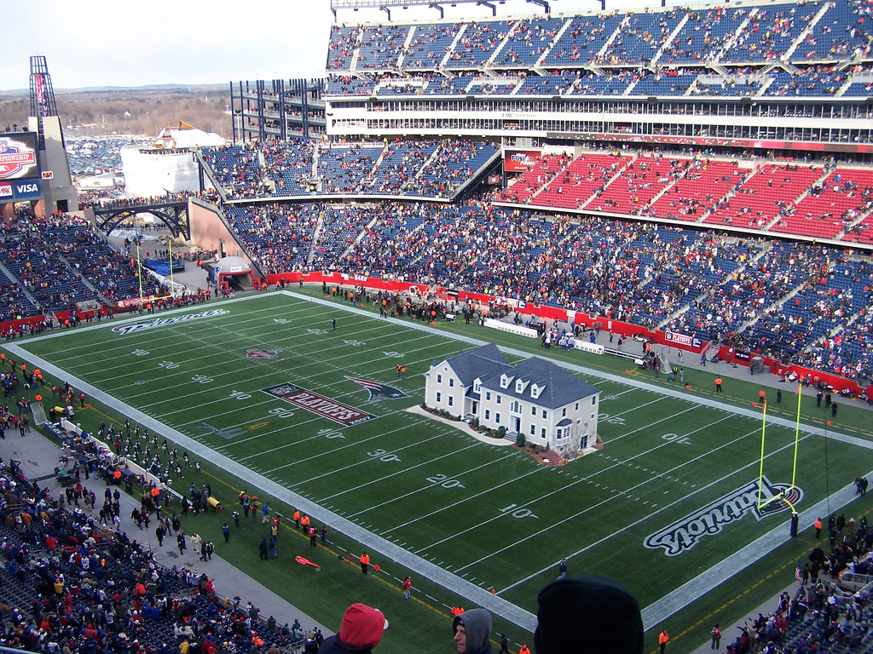



Are we building for the future or the past?
Greater Boston average lot size:
What’s Different?
Demographics: aging population, living longer, smaller family sizes, increasing diversity, more transient
Preferences: increasing preference for walkable communities, decrease car dependency, limit environmental impact, conscious of resiliency needs
Work: where we work, how we work, job opportunities; loss of middle income jobs, growth in low and high income (access)
Technology: everything!

Slide 14

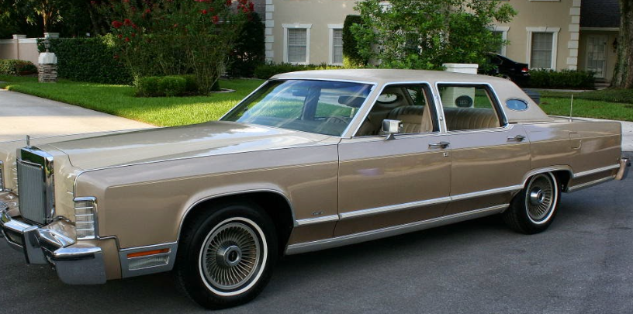
Massachusetts Zoning and other
Land Use Regulations
Our zoning is old
M.G.L. Chapter 40A- “The Zoning Act,” was enacted in 1975 Replaced Previous Act of 1954, and 1918
975
Our water & sewer regulations are old, many based on 1978 assumptions such as:
The decrease in family size
The use of water conserving fixtures and plumbing, for example a washing machine in 1978 used 40-50 gallons per load, today as little as 17 gallons
Notes:
Our current Act has remained virtually unchanged for 43 years. That predates cell-phones, and the common use of desk top computers. This is particularly noticeable in the procedural sections of the Act, which require physical posting of notices in public places, listing of hearings in print journals only, and no requirements for language accessibility.
As many of you are aware, recent efforts to modernize our zoning act were defeated this past summer.

Slide 15













MASSACHUSETTS HOUSING CHALLENGES; MULTI-FACETED AND SOLVABLE (but not easy)
HOUSING SOLUTIONS ARE NEED AND ENVIRONMENT SPECIFIC
Expensive urban
jobs, access, fun, displacement
Struggling urban
poor transit, secondary job markets, lower incomes, prohibitive rehab due to state building codes
Expensive rural second homes
Struggling rural
aging population, weak economy, struggling public schools, no broad band
Expensive suburban
high ranking public schools, vibrant town centers
Struggling suburban
Sprawl, little or no transit, limited local services, weak local economy
INFRASTRUCTURE: THE FOUNDATION UPON WHICH WE THRIVE (OR NOT) a.k.a. PUBLIC INVESTMENT

Slide 16

Exclusionary Zoning through the lens of Fair Housing
Shelly Goehring
Senior Program Manager

Slide 17
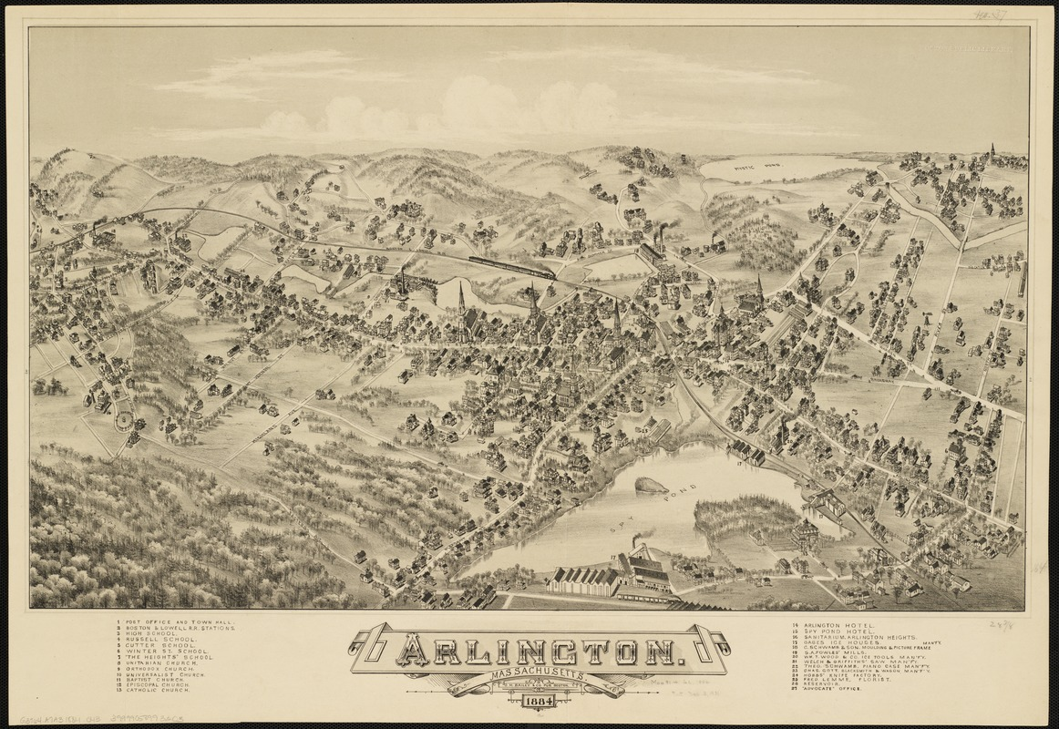
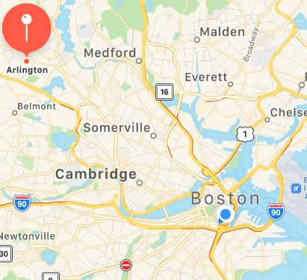
1884
Arlington, MA

Slide 18
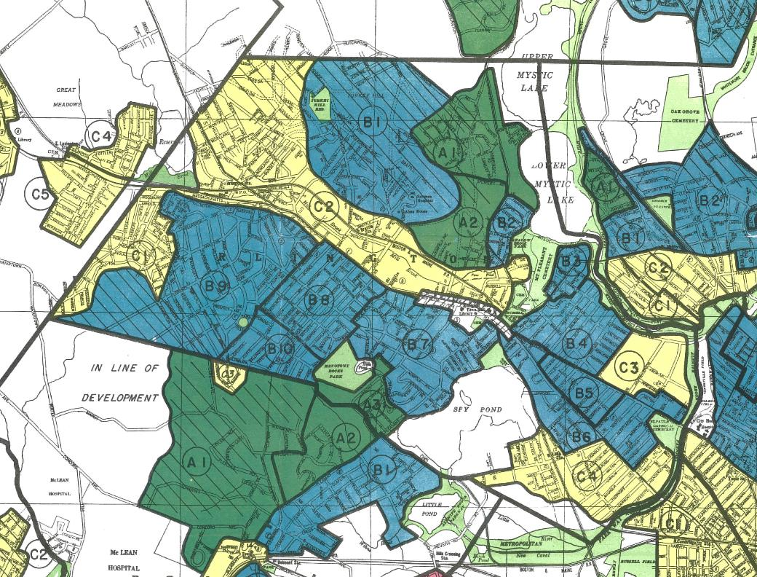
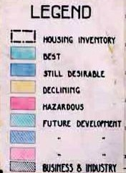
1938
Arlington, MA
Home Owners’
Loan Corporation

Slide 19
Arlington district C-2
Why is it “declining?”
  Area Characteristics
    Detrimental Influences: “Obsolescence. Business and housing mixed together. Railroad tracks through neighborhood.”
    Trend of desirability next 10-15 years = DOWN
  Inhabitants
    Occupation: clerks –labor
    Estimated annual family income: $1,500-2,500
    Foreign-born families: Italian
    Infiltration of: Lower class
  Clarifying Remarks
  Little possibility of conversion of properties to business use.

Slide 20
Arlington’s First Zoning Map - 1924
Yet Arlington remained largely “pro-growth.”
1945 – district to allow four stories or 60’ height
(10+ more created, largely in NE & 7 blocks along Pleasant)
Von Hoffman, Alexander. “Creating an Anti-Growth Regulatory Regime: A Case from Greater Boston.” Joint Center for Housing Studies, Harvard University. Feb. 2006.

Slide 21
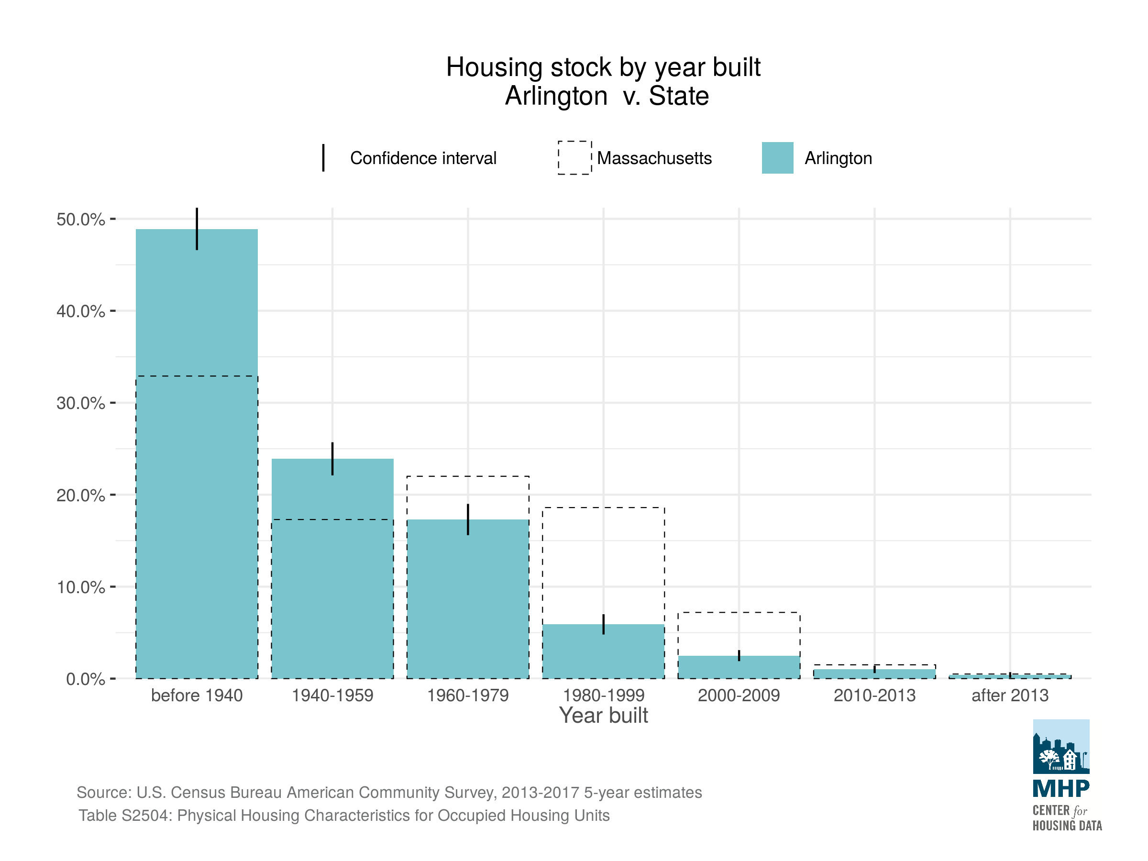
Most of Arlington’s housing was built before 1980.

Slide 22
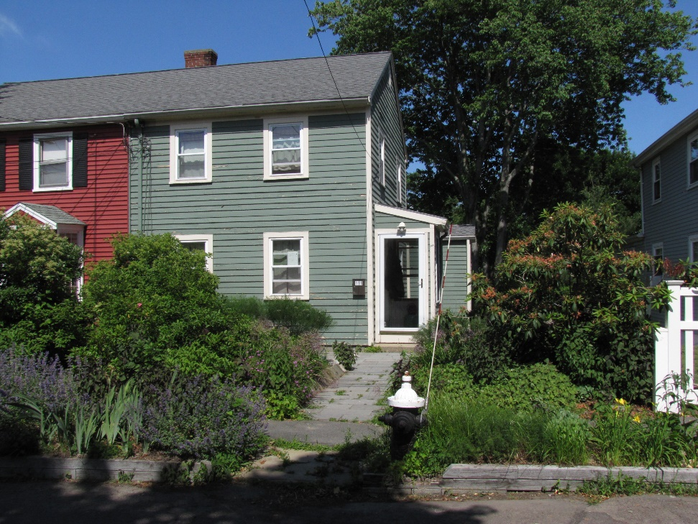
Arlington Single Family Attached Homes
Sunnyside Avenue, Two-Family zoning district
Built in 1948 and
sold for $6,250
$6,250 = $65,366 in today’s dollars
$65,366
$384,600
488%↑
Source: Town of Arlington,
Bureau of Labor Statistics

Slide 23
2015
Arlington, MA
Zoning Map

Slide 24
What Changed?

Slide 25
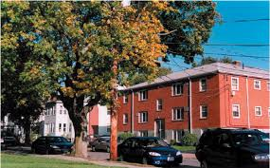
The Arlington “Pillbox”

Slide 26
Conservation and Historic Movements
1960s and 1970s
1966 – Arlington Conservation Commission
Enabled by state legislation – protect and develop the town’s natural resources, conduct research, draw plans and recommend actions
1970 – Arlington Historical Commission
Purpose to preserve & protect historic buildings, discourage demolition, advise town building inspector
Von Hoffman, Alexander. “Creating an Anti-Growth Regulatory Regime: A Case from Greater Boston.” Joint Center for Housing Studies, Harvard University. Feb. 2006.

Slide 27
Arlington created a Redevelopment Board
1970s as “anti-growth” movement grew
Reversed town’s “pro-growth” policy
Two-year moratorium on multifamily development
(154-17 TM vote)
New zoning in 1975 – ↑ lot size, ↓ height, ↑ parking, ↑ zoning districts
“Residents should be the ultimate decision makers about how the area they live in should be developed.”
Von Hoffman, Alexander. “Creating an Anti-Growth Regulatory Regime: A Case from Greater Boston.” Joint Center for Housing Studies, Harvard University. Feb. 2006.

Slide 28
2015
Arlington, MA
Zoning Map

Slide 29
Many only develop in Arlington once.
--long-time Arlington real estate lawyer

Slide 30

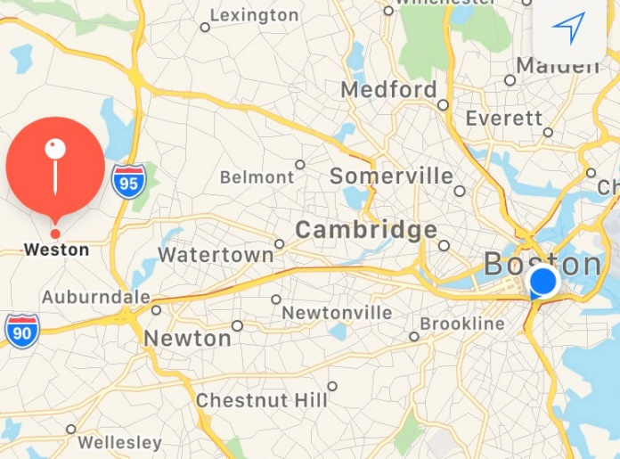
Weston, MA
~15 miles from downtown Boston
Three commuter rail stops -- Fitchburg line
Access to 90, 95 and Routes 20, 30 and 117
Almost 1/5 of land is public forests, conservation land or parks
Much of the private land is woods, meadows and lawns
No public sewer

Slide 31
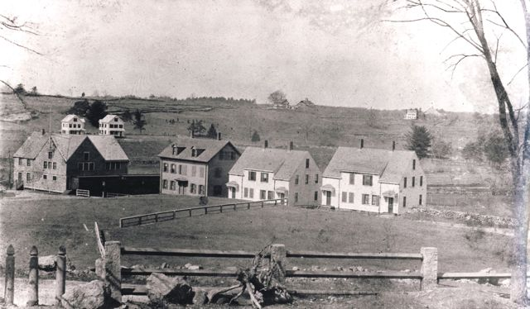
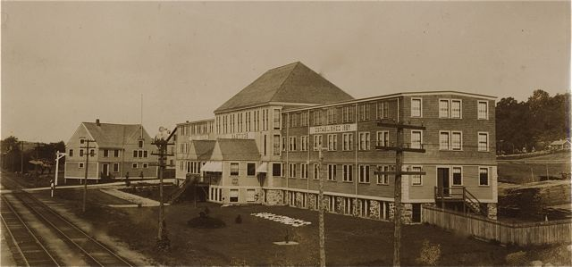
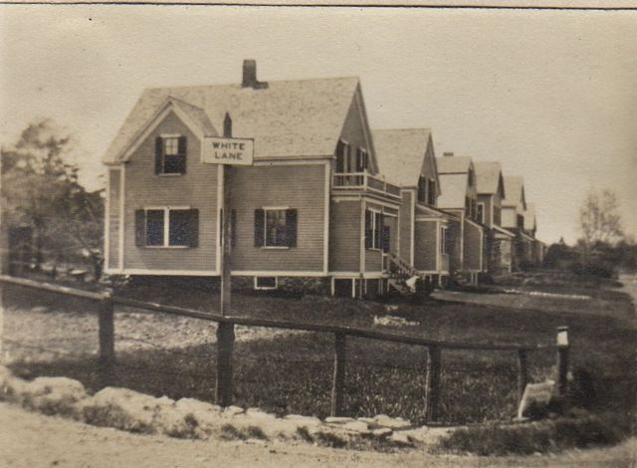
Hastings Organ Factory
Built on farm fields in the Hastings family since the early 19th century. Near the railroad and Stony Brook.

Slide 32
What Changed?

Slide 33
Resident Leadership Changed
1820s Summer residents and gentlemen farmers move in. By late 1880s, began separating from others.
1890+ Began suppressing industry to protect scenery.
1954 New zoning designed to curb growth by increasing lot size. Remaining developable land put in Residential Class A (minimum 60,000 square feet).
Second growth control measure, increased buying conservation land.
1955-75 Adds 1,300 acres of open space to the 50 acres owned in 1945.
Almost 12% of Weston’s total area.
www.westonhistory.org and “To Preserve and Protect: Land Use Regulations in Weston, MA” by Alexander von Hoffman.

Slide 34
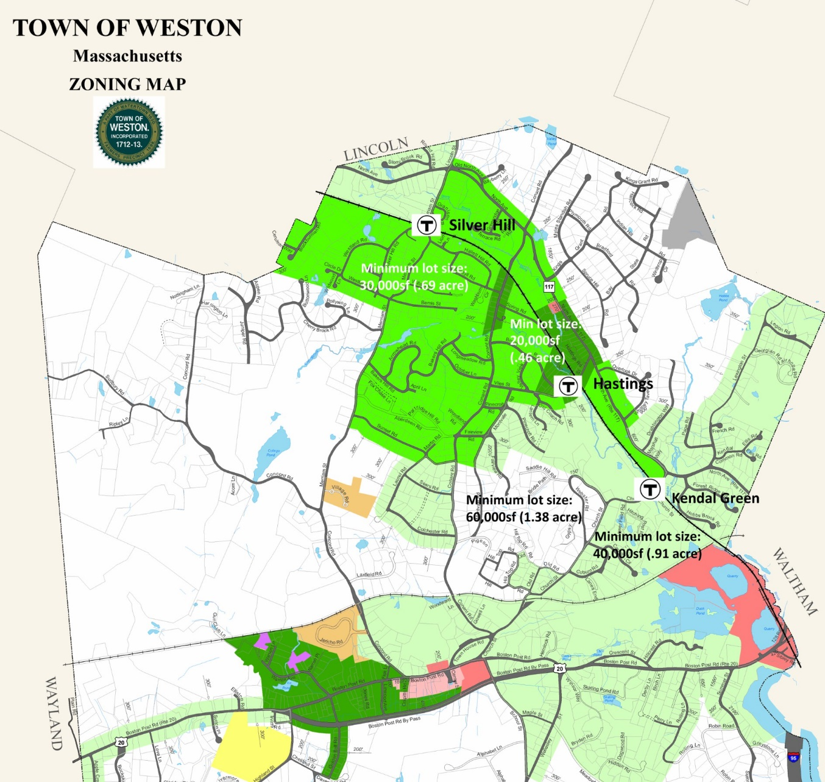
Weston
Minimum lot sizes
Dark Green = 20,000 square ft
(0.46 acre)
Bright Green = 30,000 square ft
(0.69 acre)
Light Green = 40,000 square ft
(0.91 acre)
White = 60,000 square feet
(1.37 acres)

Slide 35
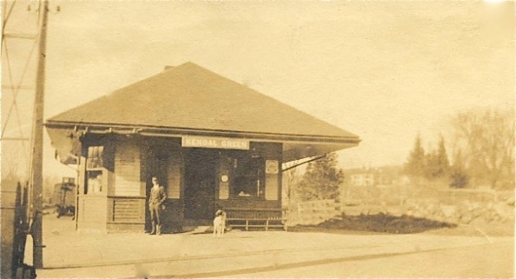
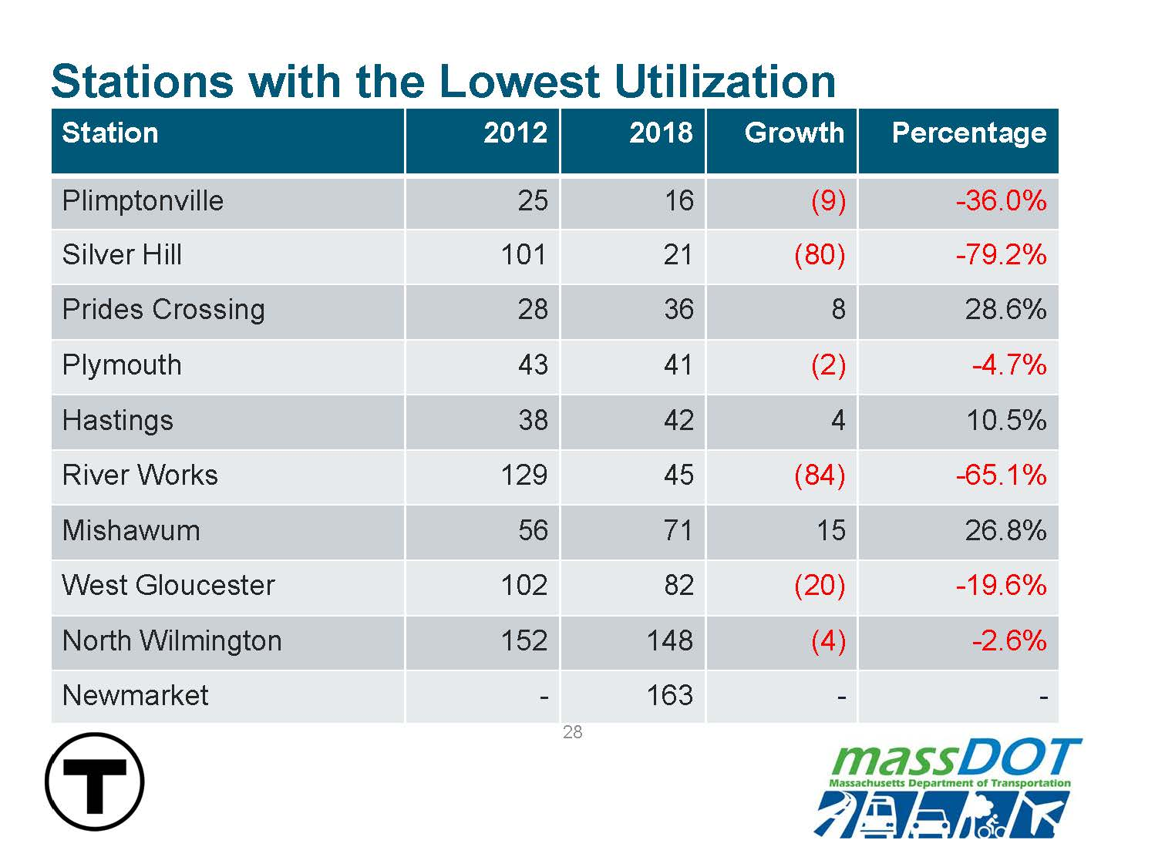

Slide 36
Weston Compared to Neighbors
Community | Total Area (square miles) | Population (est. 2018) | Population per Square Mile | Car Miles to Downtown Boston
Lincoln | 14.4 | 6,797 | 472 | 18
Natick | 15.1 | 36,229 | 2,399 | 21.1
Newton | 18.1 | 88,904 | 4,912 | 9.7
Waltham | 12.7 | 62,962 | 4,958 | 11.6
Wayland | 15.2 | 13,882 | 913 | 20
Wellesley | 10.2 | 29,673 | 2,909 | 16.7
Weston | 17.0 | 12,134 | 714 | 15
Boston 14,387

Slide 37
History of Housing Discrimination
1917
Buchanan v. Warley
Zoning by race outlawed
1948
Shelley v. Kraemer
Racial covenants outlawed
1968
Federal Fair Housing Act
Today
Exclusionary zoning persists

Slide 38
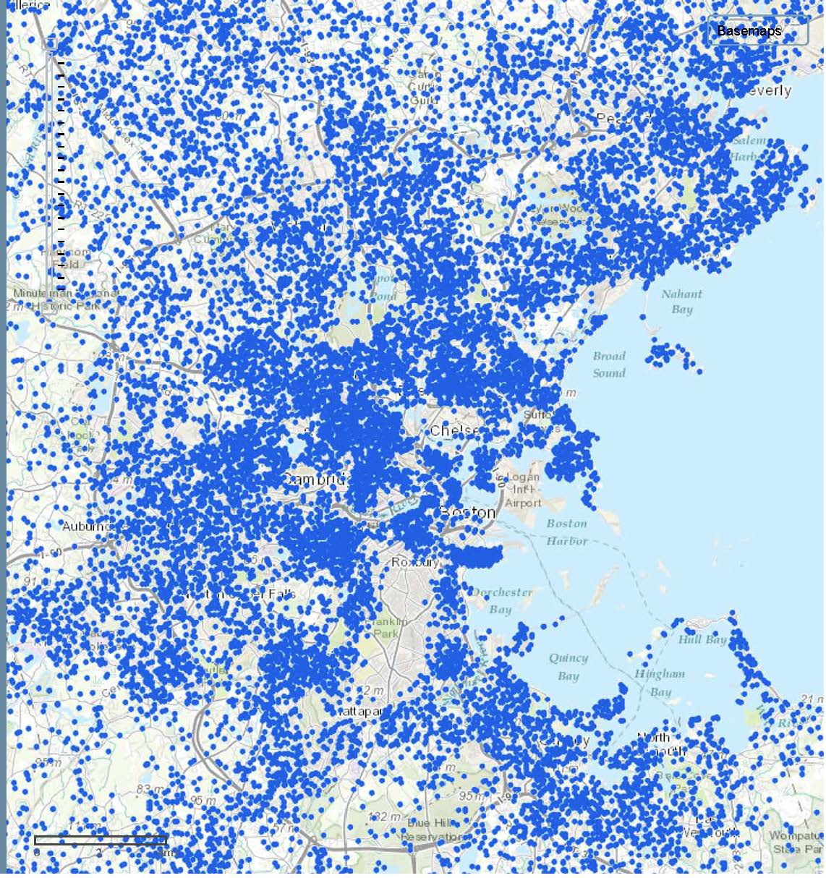
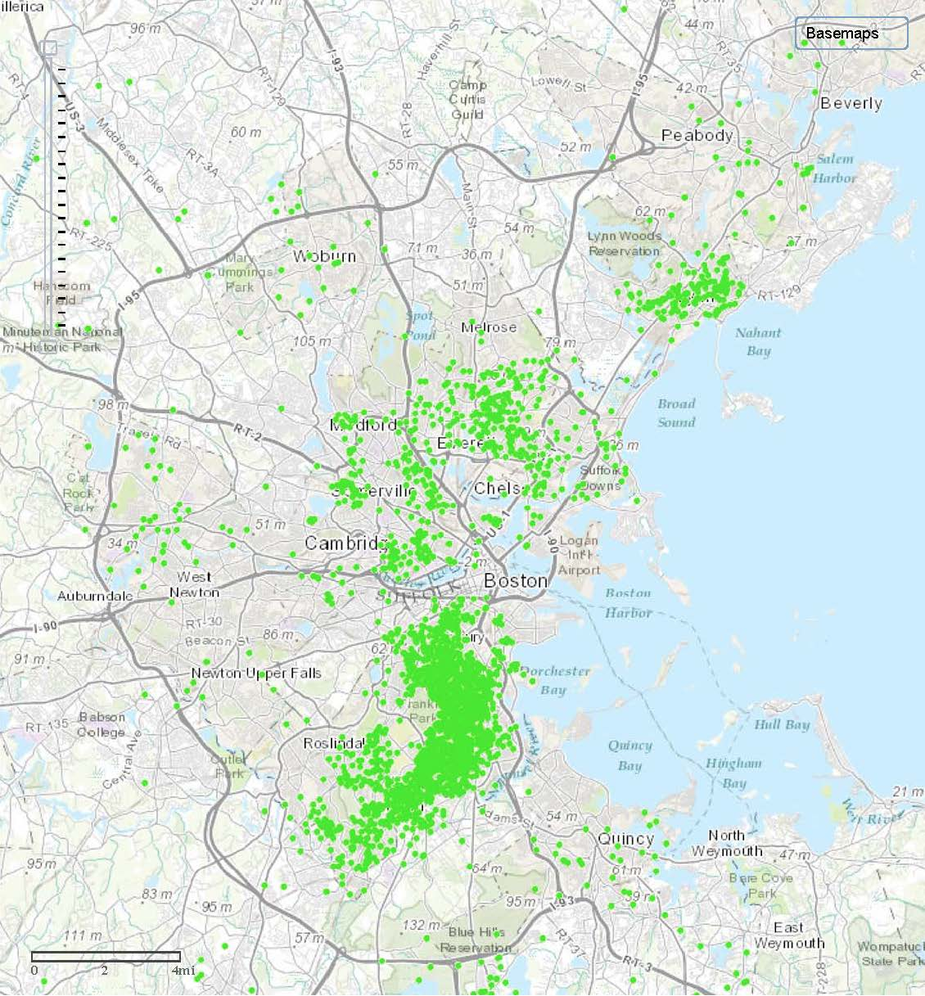
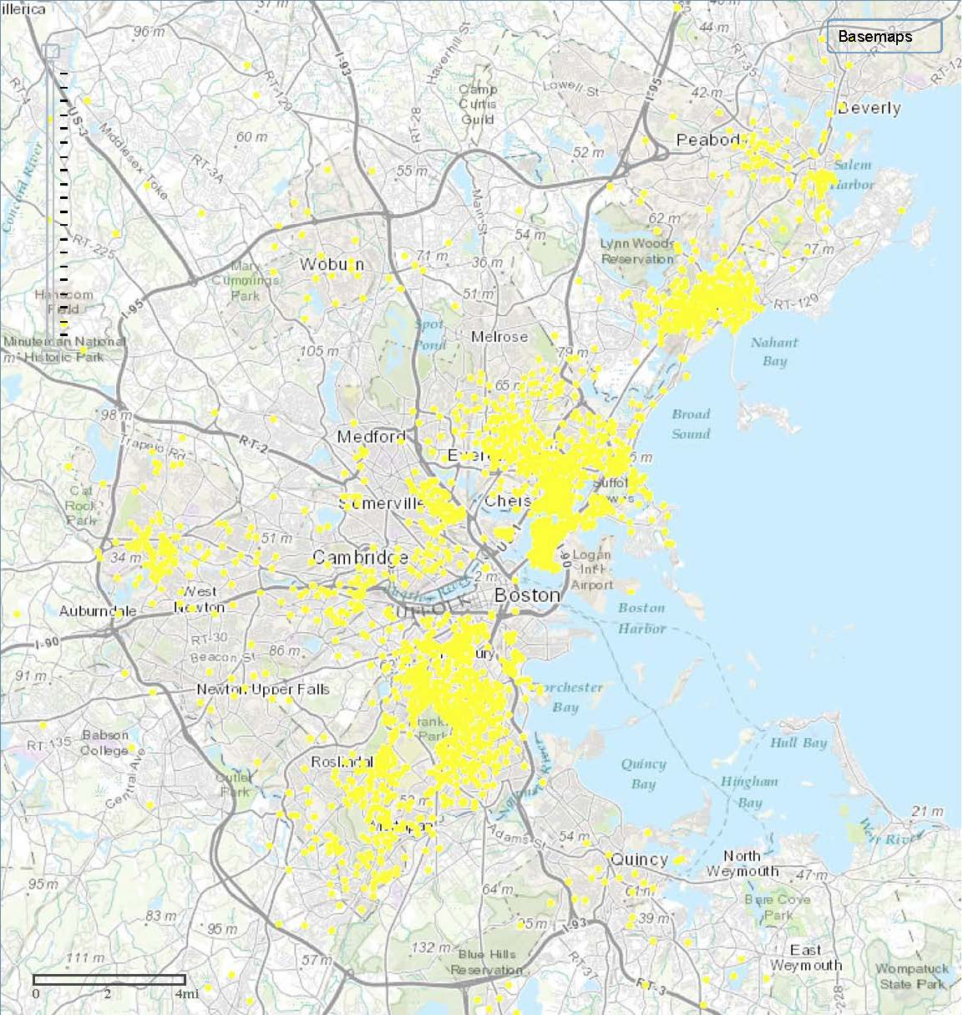
Whites Blacks Latinos

Slide 39
By 2010 in Massachusetts
Town/City | White (%) | African-American/Black (%) | Asian (%)
MASSACHUSETTS | 80.4 | 6.6 | 5.3
Arlington | 85.7 | 2.4 | 8.3
Belmont | 83.5 | 1.8 | 11.1
Brookline | 76.7 | 3.4 | 15.6
Canton | 84.8 | 6.3 | 6.1
Cohasset | 97.3 | 0.3 | 1.0
Dedham | 88.4 | 5.4 | 2.6
Hingham | 96.2 | 0.5 | 1.5
Milton | 77.4 | 14.3 | 4.1
Needham | 90.8 | 1.0 | 6.1
Newton | 82.3 | 2.5 | 11.5
Stow | 93.6 | 0.7 | 3.3
Sudbury | 90.8 | 0.8 | 5.9
Weston | 85.3 | 2.0 | 9.9
2010 Census

Slide 40
Exclusionary Zoning
Use of zoning ordinances to exclude certain types of land uses from a given community.
What it looks like:
Large minimum lot sizes
Only one home per lot
Low income housing only in currently low income (or less affluent) neighborhoods

Slide 41

Large lot zoning drives up costs.
Greater Boston
median lot size:
Greater Boston
average lot size:

Slide 42
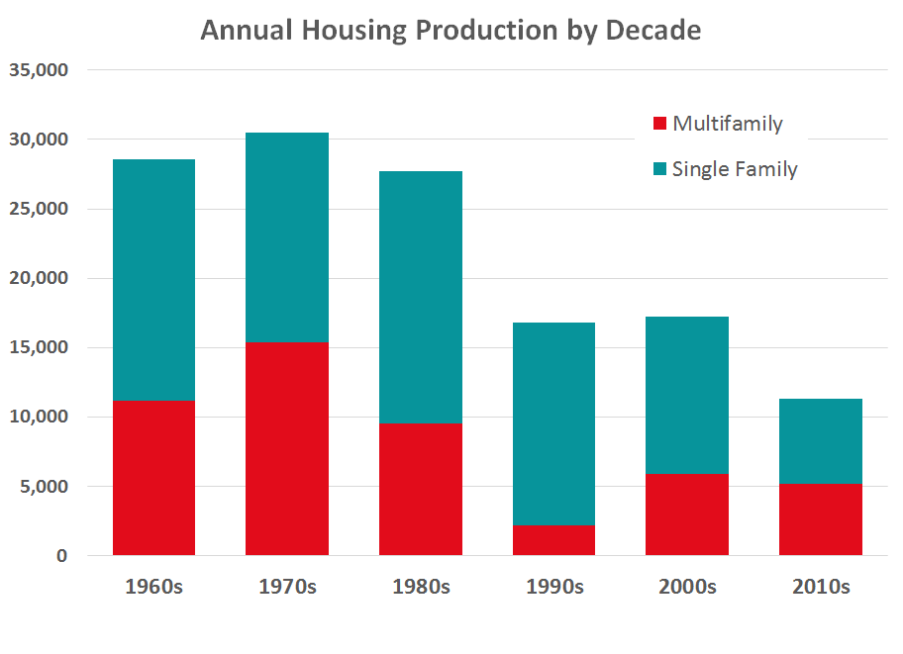
Limiting housing production.

Slide 43
These unlawful practices include zoning laws and other housing restrictions that function unfairly to exclude minorities from certain neighborhoods without any sufficient justification. Suits targeting such practices reside at the heartland of disparate-impact liability.
--Justice Kennedy, Texas Department of Housing and Community Affairs v. Inclusive Communities Project, Inc. (5-4 decision)

Slide 44
“Class” is not a protected class under the Fair Housing Act
State (M.G.L. c. 151B)
All federal bases plus:
Ancestry
Age
Marital Status
Source of Income/Public Assistance
Sexual Orientation
Gender Identity
Veteran History/ Military Status
Genetic Information
Federal (Fair Housing Act)
Race
Color
National Origin
Religion
Sex
Familial Status
Disability

Slide 45
But class has
racial implications.

Slide 46
Racial Wealth Gap
Homeownership contributes
27% to racial wealth gap
(Single biggest share)
Difference in income contributes
20% to racial wealth gap
Brandeis Institute on Assets & Social Policy, “The Roots of the Widening Racial Wealth Gap: Explaining the Black-White Economic Divide,” 2013.

Slide 47
Homeownership policy
Homestead Act
FHA
(redlining)
GI Bill
(post WWs)
Racial covenants* (Levittown)

Slide 48
Massachusetts Homeownership
Racial gap = 49th in nation
Households of Color
31%
White Households
69%
www.scorecard.prosperitynow.org/2016

Slide 49
The Consequences are REAL
Takes 8 more years for A-A household to buy
  Lower incomes and less inheritance
Slower to accumulate equity
More wealth in home
  53% Black vs 39% White
Greater impact from housing market volatility
Brandeis Institute on Assets & Social Policy, “The Roots of the Widening Racial Wealth Gap: Explaining the Black-White Economic Divide,” 2013.

Slide 50
A Look at Net Worth
Brandeis Institute on Assets & Social Policy, “The Roots of the Widening Racial Wealth Gap: Explaining the Black-White Economic Divide,” 2013.

Slide 51
The Color of Wealth in Boston
Federal Reserve Bank of Boston report

Slide 52
"Massachusetts has a history of being a welcoming community for absolutely everyone. We have a chance to once again clearly and loudly proclaim that everyone is welcome here in Massachusetts.“
-- MA legislator

Slide 53
Emerging Housing Legislation
Zoning Reforms
  Housing Choice
  Housing Production
New Revenue for Housing
  Community Preservation Act
  Transfer Tax
  Deeds Excise Fee
Fair Housing
  Eviction Records Sealing
  Discriminatory Land Use
Anti-Displacement
  Right to Counsel
  Tenant Opportunity to Purchase
  Rent Control
Housing Quality
  Neighborhood Stabilization

Slide 54
Housing Choice (H.3507)
Governor Baker’s bill would change state law to reduce the required vote from a 2/3^{rds} supermajority to a simple majority for certain smart growth zoning changes:
  Adopting mixed-use, multi-family, & 40R zoning in town centers & near transit
  Adopting cluster zoning
  Reducing parking & dimensional requirements, such as minimum lot sizes
  Allowing transfer of development rights
  Allowing accessory dwelling units (ADUs)
  Adopting special permits for mixed-use or transit-oriented affordable housing developments
Notes:
As part of its Housing Choice Initiative, Governor Baker also filed legislation with zoning reforms to facilitate housing production and adoption of zoning best practices by lowering voting barriers without mandating that cities and towns adopt any specific zoning practices.
The Act would have changed state law to reduce the required vote from 2/3 “supermajority” to a simple majority for certain zoning changes.
In addition, the legislation would have authorized adjacent municipalities to enter into agreements for sites that span multiple communities. It would have also required regular reporting on progress made towards the 135,000 new unit goal as well as how Housing Choice Communities were using their new resources.
Although the bill received widespread support from real estate groups, housing advocates, the Mass. Municipal Associatoin, and business leaders, it did not pass by the end of the legislative session in July. It will likely be refiled in January, with opportunities to strengthen and improve

Slide 55
Housing Production Bill (H.1288 & S.775)
This legislation incorporates the Housing Choice bill and includes three additional provisions to create more housing, reduce barriers to production, and set affordable housing goals:
  Require municipalities served by the MBTA to allow multifamily zoning around public transportation
  Abutter appeals reform to discourage frivolous lawsuits to stop development
  Setting a statewide affordable housing production goal

Slide 56
Community Preservation Act (H.2463 & S.1618)
This legislation would increase funding for the statewide Community Preservation Trust Fund by raising the recording fee at the Registries of Dees to provide a higher state-match to CPA communities.
Language to achieve this through the state budget is also currently pending.
If the budget language passes, the recording fee would increase by $30, raising an estimated $36 million each year for CPA communities to support affordable housing, open space preservation, and recreation.

Slide 57
New Revenue for Housing
Transfer Fee Legislation
  There are a variety of bills that would allow municipalities the local option create a transfer fee on real estate transactions
  Any funds raised would be used by the municipality to support affordable housing
Deeds Excise Fee Increase (S.10)
  Legislation filed by Governor Baker to raise the deeds excise fee to fund climate resiliency measures
  Proposed increase from $2.28 for every $500 of value to $3.42 for every $500
  Estimated to general $137 million annually

Slide 58
Fair Housing
Eviction Records Sealing (H.3566 & S.824)
  This legislation would seal certain eviction records to protect tenants if they don’t have a judgement against them, if they weren’t evicted, or if they didn’t do anything wrong
  This includes no-fault evictions, if a tenant is seeking repairs, or if an eviction record is more than 3 years old
Prohibiting Discriminatory Land Use (H.1344 & S.781)
  This legislation would prohibit cities and towns from discriminating against a development because it has affordable housing or is suitable for families with children.

Slide 59
Anti-Displacement Polices
Right to Counsel
  There are several bills that would provide a right to counsel for low-income residents in Housing Court
Tenant Opportunity to Purchase
  There are several pieces of legislation that would allow tenants in a multifamily building a right of first refusal to purchase if the building is put up for sale
Rent Control (H.1316)
  This bill would allow a local option for municipalities to enact rent control

Slide 60
Neighborhood Stabilization (H.177 & S.1627)
This legislation would assist Gateway Cities and rural towns address distressed vacant housing that continues to deteriorate, cause blight, and further weaken struggling housing markets by:
  Creating a spot blight rehabilitation program
  Establishing a commission on bringing older buildings up to code, cost-effectively, in weak real estate markets
  Requiring EOHED to create a capacity-building program to assist cities and towns initiating new neighborhood stabilization programs and practices

