Slide 1
AFFORDABLE HOUSING
Agencies Supporting Affordable Housing in Massachusetts
FEDERAL
HUD
IRS
Low Income Housing Tax Credit
Public Housing
STATE
(Quasi-public Housing Agencies)
Department of Housing and Community Development
Public Housing
Public Housing Authorities
MHP
MassHousing
MassDevelopment
CEDAC
MUNICIPAL
Resources (land, money…)
Support
Money
MHIC
Foundations
LISC, Enterprise, and Others
PRIVATE
NON-PROFIT
Capacity
Community Development Corporations
Regional Non-Profits
LISC, Enterprise, and Others
FOR-PROFIT
Money
Capacity
Banks
TLI/PCI
Development Companies

Slide 2
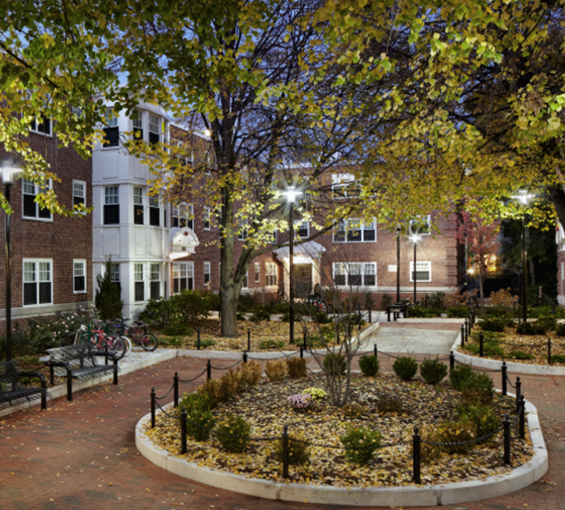
Massachusetts Public Housing
FEDERAL PUBLIC HOUSING
33,000 Federal Public Housing Homes
18,000 family
15,000 elderly disabled
LHA reports directly to HUD
Capital sources: HOPE VI, Promise Zones, RAD…
LEVERAGE
Operating sources: Section 8….
STATE PUBLIC HOUSING
44,000 state public housing homes
Approx 2/3 elderly/disabled
Upto 80% AMI
Majority 30% AMI
MGL Ch 121b
Public entity created by state law / not part of the municipality
760 CMR: DHCD*
760 CMR 4.00 General Administration of Local Housing Authorities
234 Local Housing Authorities
*CMR Code of Massachusetts Regulations

Slide 3
Area Median Income
https://www.nhc.org/paycheck-to-paycheck/

Slide 4
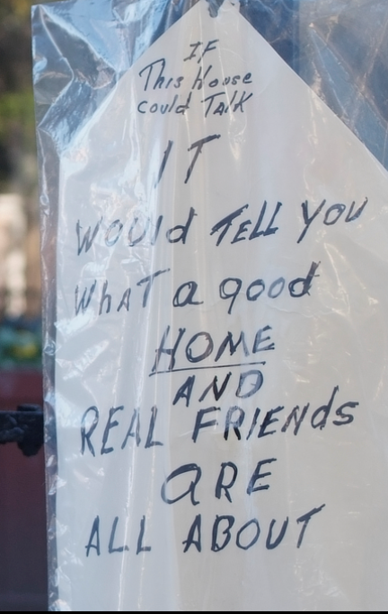
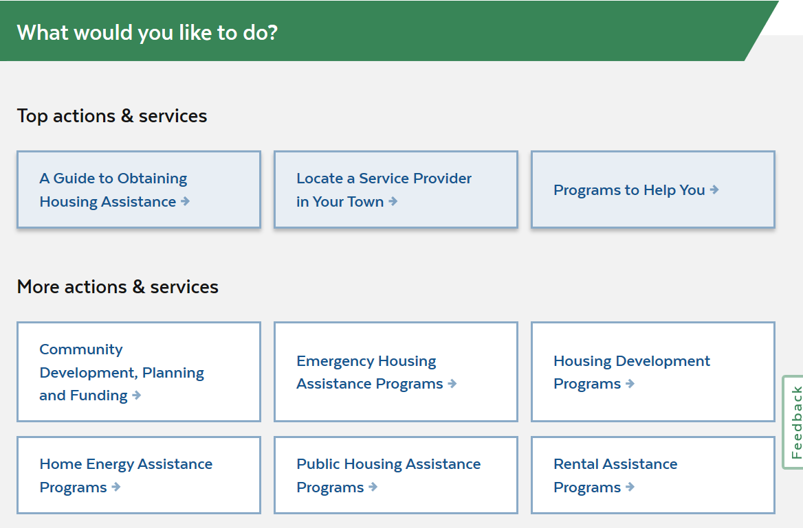
Massachusetts State Public Housing

Slide 5
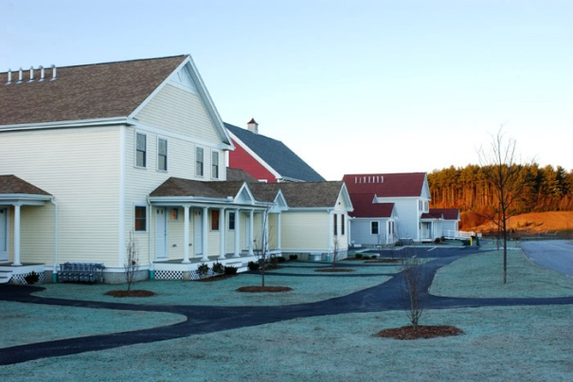
Resources for New Affordable Housing Production
State Public Land
State: DOT – Department of Transportation
DCAMM – Division of Capital Asset Management and Maintenance
Municipal
Local Housing Authority

Slide 6
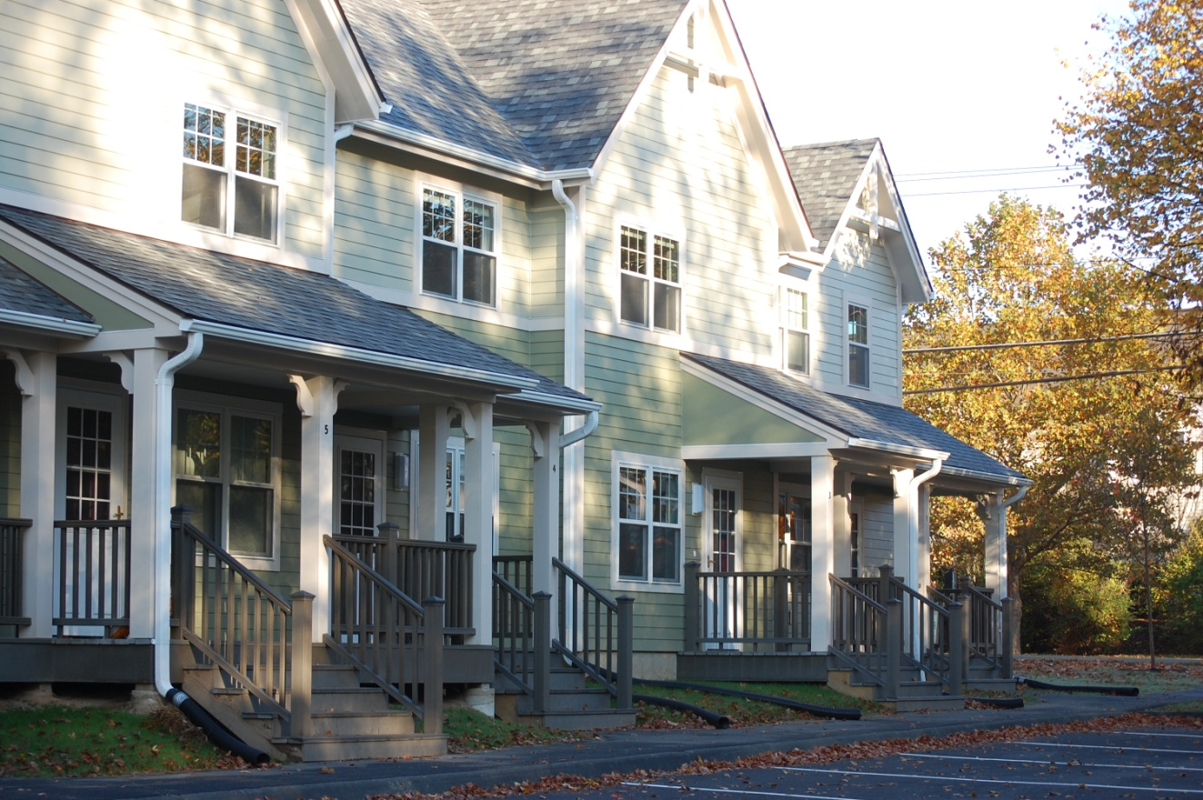
Protecting Public Interest Municipal and LHA
MGL Ch. 7C – designer selection
MGL Ch. 30B
MGL Ch. 121b
MGL Ch. 149
Who has a say? State Level: DHCD, AG, IG, possibly legislature
Local Level: Planning board, zoning board, board of health, LHA commissioners, neighbors, conservation commission, elected officials, town meeting

Slide 7
Notes:
So with everything so expensive, including new rentals, it seems like we should be building more Affordable capital A.
We cannot subsidize our way out of this problem
Providing subsidy is expensive, and we have limited resources
Amount of subsidy available in the state annually

Slide 8
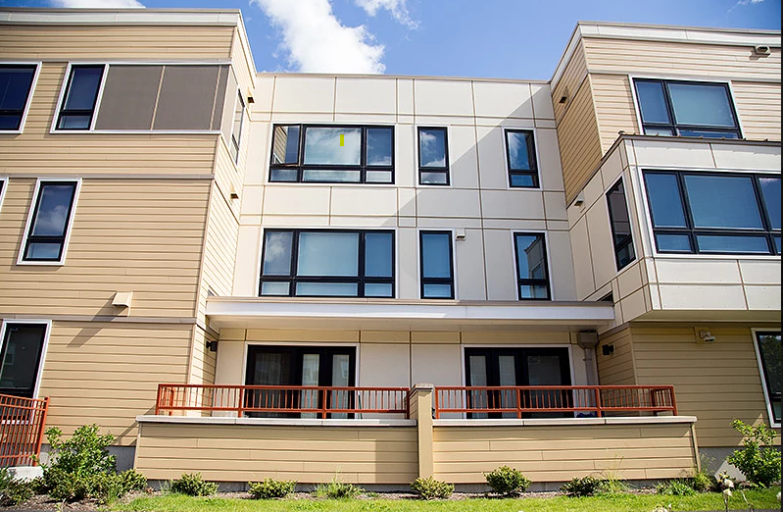
How are we trying to improve the system?
Session Law – Acts of 2014 Ch.235 – An act relative to housing authorities
Regulation 760 CMR 5.00
CH. 121b Sec 38D
Trainings
Tenant representation
Collaboration
CHAMP – online application
For public housing

