Slide 1
Affordable Housing Resources: Public Housing & Rental Assistance
Eric Shupin
Director of Public Policy
Citizens’ Housing & Planning Association

Slide 2
Affordable Housing Resources
Public Housing
Rental Assistance
Other Affordable Housing Options & Search Tips
Program Descriptions
Basic Program Info
Administering Agency
Income Eligibility
Rent Level
Where to Apply
Waitlist

Slide 3
AMIs are set annually by U.S. Dept. of Housing & Urban Development (HUD) and vary by region and family size. AMIs can be searched by municipality at: https://www.huduser.gov/portal/datasets/il/il2019/select_Geography.odn
Area Median Income (AMI)
Boston (4-person household):
80% AMI (low-income): $89,200
50% AMI (Very low-income): $59,250
30% AMI: (Extremely low-income): $35,550
Pittsfield (4-person household):
80% AMI (low-income): $70,950
50% AMI (Very low-income): $44,350
30% AMI: (Extremely low-income): $26,600

Slide 4
Affordable, rental housing for low- and moderate-income households owned by a housing authority
Public Housing
Public Housing
Administered by | Local Housing Authorities (LHAs)
Income Eligibility | <80% AMI
Rent Level | About 30% of monthly income
Where to Apply | At each housing authority or through new online application
Waitlist | Online waitlist
List of all Housing Authorities in Massachusetts:
http://www.mass.gov/hed/economic/eohed/dhcd/contacts/local-housing-authority-listing.html

Slide 5
About 78,000 public housing units at 253 housing authorities across Massachusetts
Public Housing
Housing Authorities:
Operate & Maintain public housing
Administer Rental Vouchers
Serve as a resource for other housing programs
NEW Online Application:
https://publichousingapplication.ocd.state.ma.us/

Slide 6
Housing Voucher programs provide rental assistance to help low-income residents afford apartments – the voucher covers the difference between the rent charged and the tenant’s contribution
Rental Assistance
Two types of vouchers:
Mobile Voucher
Tenant finds her own apartment
Voucher stays with tenant when she moves. Can move anywhere in the Commonwealth
Rent must meet applicable fair market rent standards
If you are having trouble finding an apartment within the established fair market rents because you have a disability and need access to certain housing or medical services, the payment standard may be increased as a reasonable accommodation.
Project-Based Voucher
Voucher is attached to a particular apartment and does not move with the tenant

Slide 7
Housing Vouchers Programs
Section 8 Housing Choice Voucher Program
Massachusetts Rental Voucher Program (MRVP)
Alternative Housing Voucher Program (AHVP)
DMH Rental Subsidy Program

Slide 8
Federally funded voucher program – about 85,500 mobile vouchers
Section 8 Housing Choice Vouchers
Section 8 Housing Choice Voucher Program
Administered by | Housing Authorities & Regional Housing Agencies
Income Eligibility | <50-80% AMI
Rent Level | About 30% of monthly income
Where to Apply | Online or at housing authorities & regional housing agencies
Waitlist | Online & Centralized; long waitlist
APPLY TODAY!
www.section8listmass.org
http://www.mass.gov/hed/economic/eohed/dhcd/rental-applications-and-documentation.html

Slide 9
State funded voucher program – about 10,000 vouchers
Massachusetts Rental Voucher Program
MRVP
Administered by | Housing Authorities & Regional Housing Agencies
Income Eligibility | <80% AMI
Rent Level | 30-40% of monthly income
Where to Apply | At regional housing agencies or housing authorities
Waitlist | Waitlists at individual regional housing agencies and housing authorities
Key difference between Section 8 and MRVP vouchers – no centralized, online application or waitlist for MRVP
https://www.mass.gov/service-details/massachusetts-rental-voucher-program-mrvp

Slide 10
AHVP offers mobile vouchers for disabled persons under age 60
Alternative Housing Voucher Program (AHVP)
AHVP
Administered by | Local Housing Authorities
Income Eligibility | <80% AMI
Other Requirements | Disabled person under age 60
Rent Level | 25-30% of monthly income
Where to Apply | At an administering housing authority
Waitlist | Waitlists at individual housing authorities
Program consists of only about 650 vouchers
https://www.mass.gov/service-details/alternative-housing-voucher-program-ahvp

Slide 11
Programs Overview
 | Public Housing | Section 8 | MRVP | AHVP
Administered by | Local Housing Authorities | Regional Housing Agencies & Housing Authorities | Regional Housing Agencies & Housing Authorities | Participating Housing Authorities
Income Eligibility | <80% AMI | <50-80% AMI | <80% AMI | <80% AMI
Other Requirements |  |  |  | Disabled person under age 60
Rent Level | About 30% of income | About 30% of income | 30-40% of income | 25-30% of income
Where to Apply | Online or at the housing authority | Online or at regional housing agencies or housing authorities | At regional housing agencies or housing authorities | At an administering housing authority
Waitlist | Ask about local priority for current residents – time depends on LHA | Online & Centralized | Individual regional housing agencies & housing authorities | At administering housing authorities

Slide 12
Assistance for low-income persons who receive supportive residential services through the Department of Mental Health (DMH)
DMH Rental Subsidy
An eligible resident pays 30-35% of income
Eligible residents are:
Income eligible as determined by a housing authority;
In need of supportive residential services as determined by DMH; and
Eligible to participate in a Residential Services Program

Slide 13
Other Affordable Housing Options
Affordable housing that is owned and managed privately, including rental & homeownership units
Developers receive grants, tax credits, or other incentives in exchange for creating affordable housing units
Examples:
Inclusionary Zoning Units – developer required to set aside certain percentage of new units as affordable
40B Developments
Units built by Community Development Corporations (CDCs) or other non-profit developers
Units developed by cities and towns using local funds

Slide 14
Finding these affordable housing options can be challenging because there is no single database or program application
Search Tools & Tips
Contact a Housing Consumer Education Center
Check the city or town website
Talk with local housing authorities
Find a local Community Development Corporation (CDC) or other non-profit developer
Contact an Independent Living Center
Search www.massaccesshousingregistry.org

Slide 15
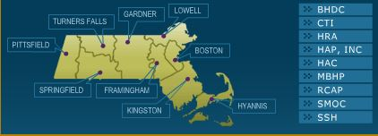
Contact a Housing Consumer Education Center (HCEC)
Search Tools & Tips
HCECs offer answers to a wide range of questions about all types of housing
9 Regional Agencies serve all of Massachusetts
Regional Agencies administer housing vouchers and other housing & homelessness prevention resources
www.masshousinginfo.org

Slide 16
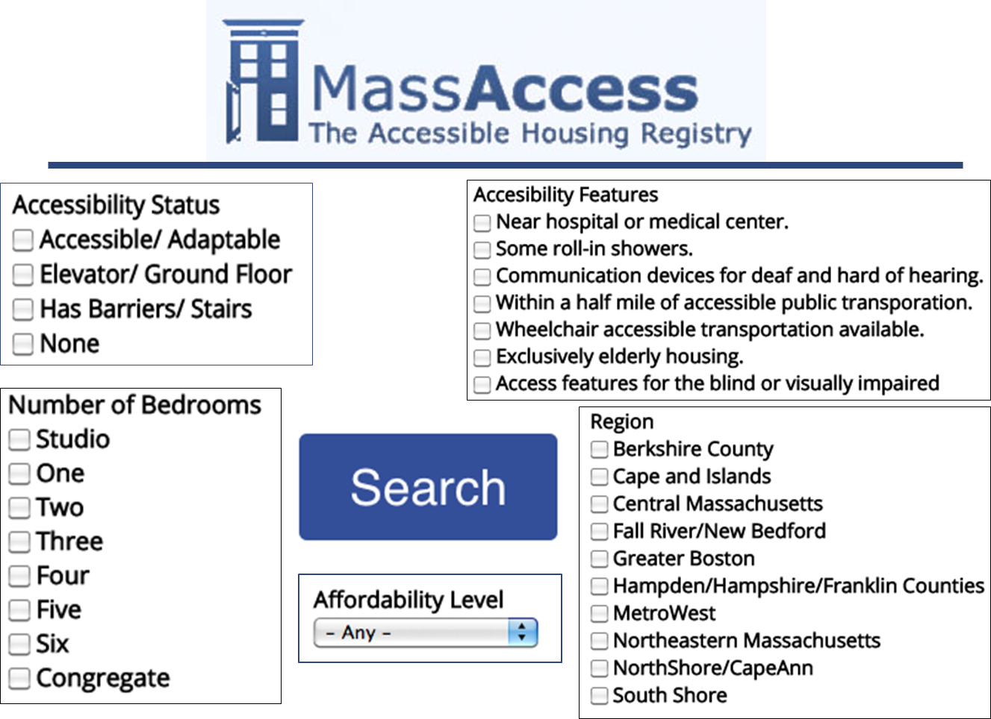
Search Tools & Tips
www.massaccesshousingregistry.org

Slide 17
Check the city or town website
Search Tools & Tips
Many cities & towns have local affordable housing committees or boards
For example, Brookline has a Housing Advisory Board
Municipalities may have information on local affordable housing opportunities
Units built through inclusionary zoning, affordable housing trust funds, or 40B developments
Request contact information for any of these kinds of developments
Talk with Local Housing Authorities

Slide 18
Find a Community Development Corporation (CDC)
Search Tools & Tips
CDCs are non-profits that work to transform communities to create and expand economic opportunities for low- and moderate-income people
CDCs are often develop affordable housing
For example, North Shore CDC manages affordable housing in Salem, Peabody, and Gloucester
There are CDCs located throughout Massachusetts.
Find your local CDC: https://macdc.org/members

Slide 19
Contact an Independent Living Center (ILC)
Search Tools & Tips
ILCs provide services to people with disabilities seeking full integration into society, including helping to find community-based, affordable housing
For example, the Boston Center for Independent Living offers a monthly Housing Workshop
11 ILCs serve the entire Commonwealth
www.masilc.org/findacenter

Slide 20
Tips for Applying for Housing
Search Tools & Tips
Apply to as many programs or developments as possible
Request to be added to any waitlist
Gather important information
Evidence of income and benefits, necessary medical records – keep information up-to-date
If necessary, request a reasonable accommodation

Slide 21
Tips for Applying for Housing
Search Tools & Tips
Be aware of any preference or priority that may apply
Keep copies and dates of any applications
Keep records of who you talk to and when
Respond promptly to any correspondence
Notify administering agencies of any changes in contact information
If appropriate, appeal a denial you receive

Slide 22
Online Resources
www.housingworks.net
National search tool for affordable housing
https://www.masshousing.com/portal/server.pt/community/rental_housing/240/looking_for_an_affordable_apartment_
Search for affordable housing developments financed by MassHousing
www.hud.gov/apps/section8/
Search for HUD subsidized affordable housing developments by municipality
www.dlc-ma.org/index.htm
Disability Law Center website with information on housing rights for the disabled

Slide 23
Online Resources
www.housingworks.net
www.massaccesshousingregistry.org
www.masshousinginfo.org
www.masslegalhelp.org
www.section8listmass.org
www.mass.gov/hed/economic/eohed/dhcd/

Slide 24
Connect with CHAPA
Eric Shupin
eshupin@chapa.org
(617) 682-9712

