Slide 1
Affordable Housing Lottery Training
November 5, 2015
Elizabeth Rust
Regional Housing Services Office,
Lottery Agent for the Sudbury Housing Trust

Slide 2
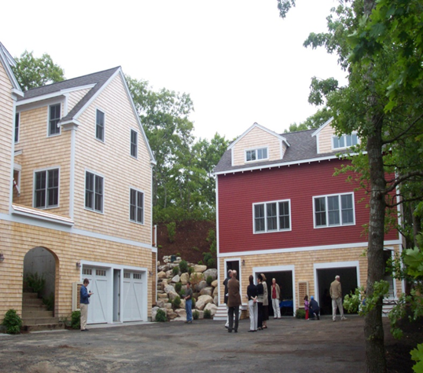
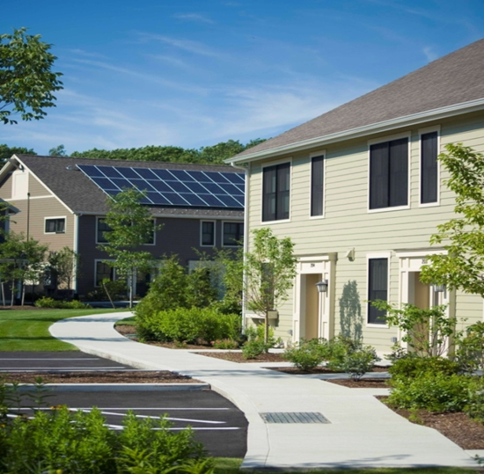
After the Plan….
This session picks up after the Affirmative Fair Housing Marketing Plan has been written and approved
Key: Clarity in the application materials contributes greatly to success!

Slide 3
Getting Started
Review Approved Affirmative Fair Housing Marketing & Resident Selection Plan
Timeline: Begin marketing 4-6 months prior to occupancy
Notes:
Minimum 60 days of advertising before lottery
Allow time to review applications for completeness and assign lottery numbers (2 weeks?)
Allow at least 30 days between award of unit and lease start (rental) or at least 45 days between P&S and closing (homeownership)

Slide 4
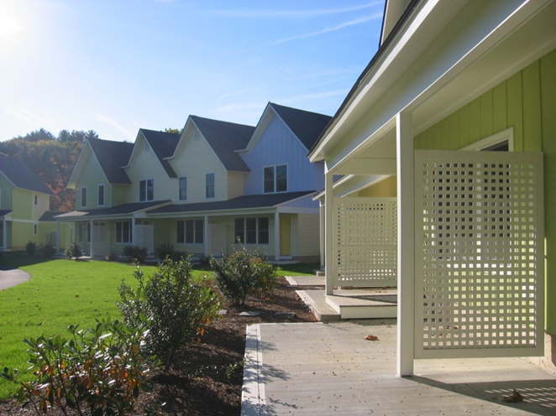
Establish/Reaffirm Sales Price/Rents
Timeline
Established at time of initial marketing or Final Approval
No earlier than 6 months before occupancy
Reviewed by Monitoring Agent (ownership), approved by Subsidizing Agency
Notes:
In phased developments, prices are established prior to the start of each phase of marketing & lottery

Slide 5
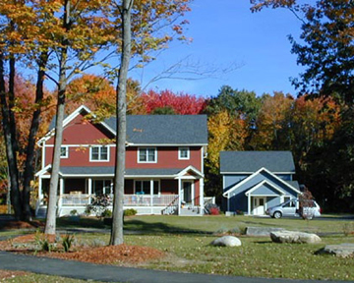
Parameters
Income limits, plus:
Ownership: interest rate, tax rate, insurance rate, condo fee (with budget and ownership schedule)
Rental: Utility schedule

Slide 6
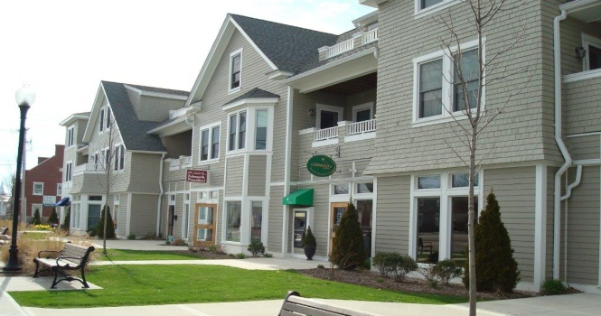
Designate affordable units
The developer should provide the lottery agent with a listing or plan of which units are affordable, at what target income.
If there is a local preference approved, the developer and agent should indicate which units will be initially local preference.

Slide 7
Open Application Period
Finalize the details
Information session and lottery: date and location
Application end date
Final review of application for clarity
Post application on-line
Execute Outreach Plan
Place advertisements, web postings, mail flyers
Place hardcopies in a public place with off-business hours
Distribute applications
Mail, email, fax as requested
Accept submitted applications
In person, by mail
Check for completeness

Slide 8
Review Applications
“Only applicants who meet the applicable eligibility requirements shall be entered into a lottery”
DHCD Guidelines 40B Sec. III F(2)(a)(1)
Preliminary eligibility must be determined prior to admittance to lottery
Notes:
Lottery Agent must have training in Determining Income – see resources list in packet

Slide 9
Determine Eligibility
Must meet eligibility of housing program and funding as specified in the AFHMP, Monitoring and subsidizing agents can assist
Review program guidelines including income targets
HUD Handbook 4350.3, Occupancy Requirements, DHCD guidelines
Establish minimum incomes, if applicable
Determine household size
Whose income to count?
Determine annual income
Paychecks, SSI, other: review deposits on bank statements
Applicant is eligible for highest income tier based on minimum income levels
Determine asset values
Impute income
Compare to limit (ownership)
Determine first-time homeowner (ownership)

Slide 10
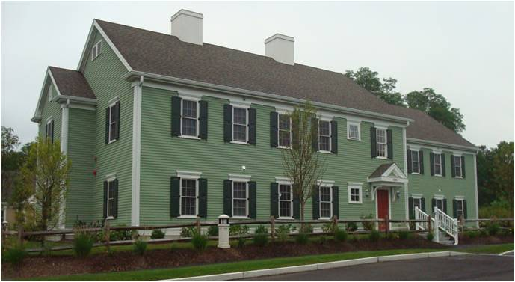
Assign Preferences – Household Size
Owners have discretion in developing occupancy standards for a property
Standards cannot violate fair housing, zoning or other restrictions and laws
Household size should be appropriate for the number of bedrooms in a unit.
First preference: Households requiring the total number of bedrooms in a unit
Second Preference: Households requiring the total number of bedrooms minus one

Slide 11
Preferences – Household Size
Criteria for determining # of required bedrooms:
There is at least one occupant per bedroom and maximum two (if specified)
A husband and wife, or those in similar living arrangement, shall share a bedroom
A person described in (2) above shall not be required to share if medical documentation
Children are not required to share a bedroom, but may
A household may count an unborn child.
If applicant is in process of divorce or separation, verification is needed
Public Housing occupancy standards may differ

Slide 12
Preferences – Household Size
2BR Examples:
Husband, wife, and 2 children
Mother and child
Husband, wife, 1 child
Husband and wife (disabled)
Disabled adult and live-in aide
Husband, wife and child at college, returning on recesses
Father and 2 children (50% custody)

Slide 13
Preferences – Local
Must be approved by the Subsidizing Agency in the AFHMP
Maximum of 70%, rounded down
Can never have durational requirement
Acceptable categories:
Current resident
Employee of the town
Employee of a business based in the town
Household with children in the school system
1 unit – 0 local | 2 units – 1 local
3 units – 2 local | 4 units – 2 local

Slide 14
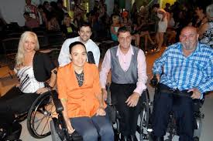
Accessible Units
For projects with mobility accessible and/or communications accessible units or adaptable units, first preference for those units always goes to households with a member that needs the features of the unit, regardless of local preference.

Slide 15
Lottery Pools
The number and type of pools will depend on the project.
For projects with approved local preference, there will be two pools: local and open.
Local applicants will be placed in both pools.

Slide 16
Assign Registration Numbers
Qualified applicants are given a lottery number
Best Practice: assign numbers to indicate household size preference, rent limit target, accessibility need, etc. Example 1001-2-50-A)
(2 bedroom, 50% AMI, Accessible)
Ballots are put in all pools that they are eligible for. Example: local preference applicant will be in both local and open pool

Slide 17
Inform Applicants
Once lottery numbers have been assigned, send a letter/e-mail to all applicants with either:
Eligibility Letter: their lottery number/s and time and place of lottery, and preferences (#bedrooms, local) or,
Ineligibility Letter: with the reason they did not qualify for the lottery, and timeframe if they want to dispute (if one hasn’t been sent earlier)

Slide 18
Local Preference & Minority Balancing
If Local Preference has been approved by the Subsidizing Agency, the Lottery Agent must determine whether the Local Pool contains at least the percentage of minority applicants as the region as a whole. If not, the minority applicant ballots from the open pool are drawn in a pre-lottery and placed in the local pool until the regional percentage is obtained.
Applicants chosen for local pool will also be in open pool.
Notes:
See Resource list for website

Slide 19
Local Preference & Minority Balancing
The minority percentage by MSA can be found at: http://www.mass.gov/hed/docs/dhcd/hd/fair/percentracialethicminority.pdf
Barnstable County------------------------- 08.6%
Boston-Cambridge-Quincy MSA------- 27.0%
Pittsfield MSA------------------------------- 09.4%
Providence-New Bedford- Fall River-- 14.4%
Springfield MSA---------------------------- 25.5%
Worcester MSA----------------------------- 19.3%
Dukes County-------------------------------- 13.7%
Nantucket County-------------------------- 19.5%
Notes:
See Resource list for website

Slide 20
Hold Lottery
Summarize lottery applicants for developer and town
#applied, #eligible in each pool
Hold in public, accessible place
Best Practice: have a disinterested party chose ballots. Typically a town official is willing.

Slide 21
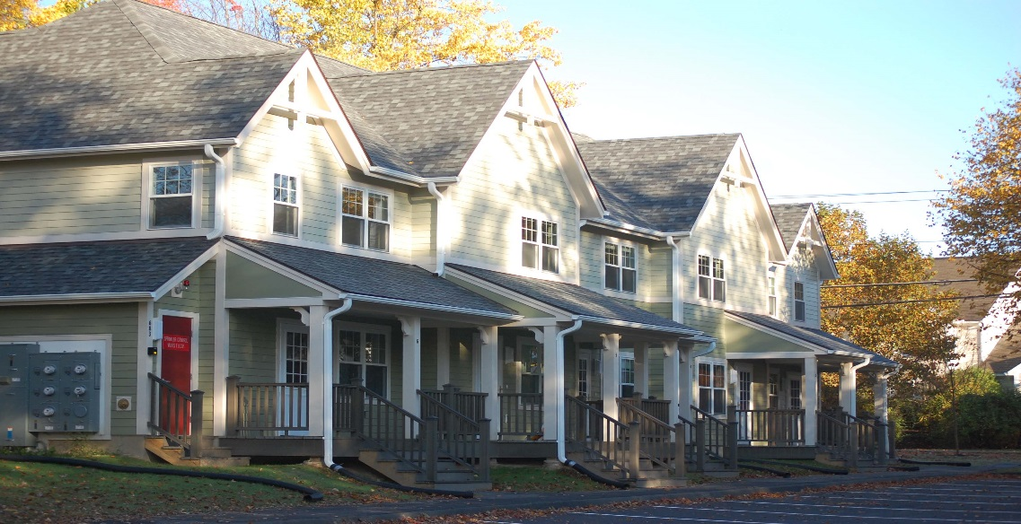
Lottery
Draw all ballots by pool and list in order
Award accessible applicants/units first
Award largest units next, beginning with the first ballot needing that size unit for that income level
If local pool, draw local ballots first, then draw all ballots from open pool
Award Sequence
Accessible
3BR 80%
3BR 50%
2BR 80%
2BR 50%
1BR 80%
1BR 50%

Slide 22
Summary
Review requirements
Verify eligibility thoroughly
Communicate explicitly with applicants
Award units carefully

